Slide 1
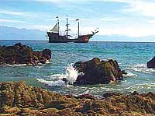
The Age of Exploration

Slide 2
Essential Questions
What were the three main motives for exploration?
Which explorers and countries were most noteworthy during this time?
What resulted from the voyages?

Slide 3
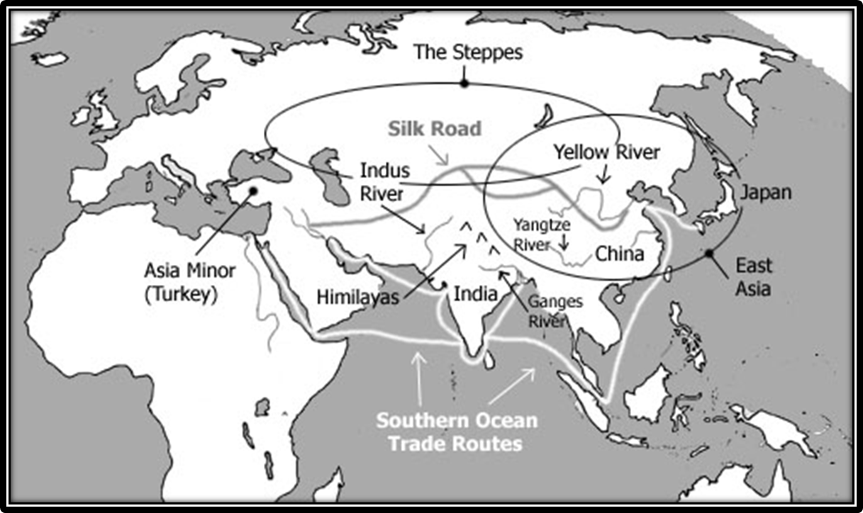
Discussion Questions: Why was Europe interested in the Asia? What was the major dilemma in getting what they wanted?
Europe wanted to trade in Asia (particularly to get spices), but several factions along the Silk Road made it an expensive and sometimes dangerous endeavor. Therefore, Europeans began seeking new trade routes. Also, the Turks in Asia Minor were dangerous.

Slide 4
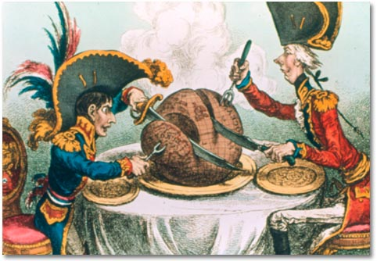
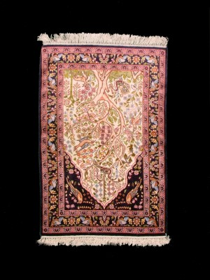
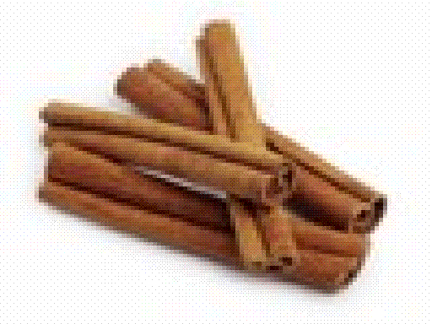
What were the three motives for exploration?
God: Wanting to Christianize heathens (especially Muslims), cultural superiority, “white man’s burden.” *Like U.S. Imperialism
2. Glory: Spirit of adventure and curiosity during renaissance, fame, nationalism. *Manifest Destiny
Gold: Rulers who trade with Asia get rich and powerful. Merchants who sell Asian goods in Europe make a lot of money. *Trade today
Previously
unknown Asian goods in high demand since Crusades.

Slide 5
What inspired the Age of Exploration?
#1. Crusades
Crusades sent many men to the Middle East to fight; a big change from their small town life! This inspired adventure and made trading connections.
#2. Trade with China
European merchants wanted to trade with China
Many took the land route on the Silk Road
Many European merchants wanted to cut-out the middleman Arab traders (who created extra charges).
So, they wanted to find new sea routes to China avoiding the Middle East
#3. The Renaissance
Inspired by trade with the Middle East, the Age of Renaissance was when Europeans became interested about everything! Science, art, math, the world, etc
Due to trade with China, they discovered new sea travel inventions such as the compass and astrolabe.

Slide 6
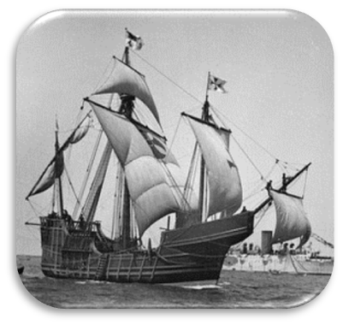
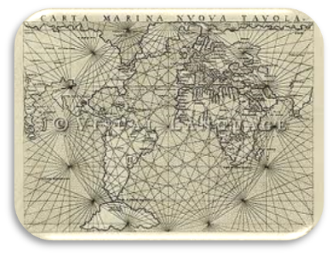
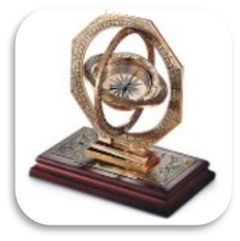
What made exploration possible?
Technology:
Smaller, sturdy ships called caravels with a smaller crew.
More accurate maps
Mariner’s compass
Weapons: Cannons and guns.

Slide 7
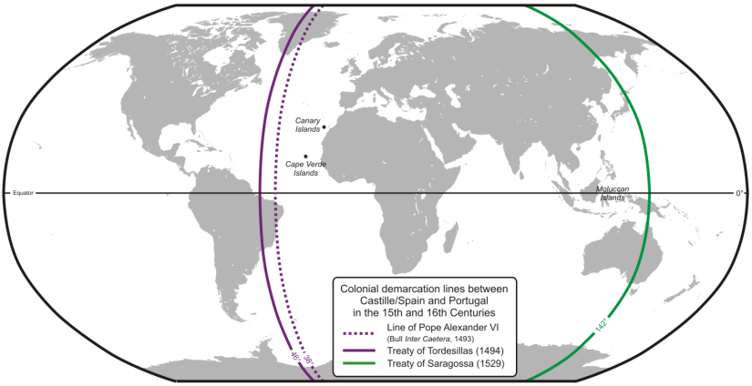
How did the Pope keep Spain and Portugal from fighting over newly discovered lands?
Line of Demarcation: In 1493, the Pope Alexander VI drew a line on the globe cutting the New World in half. This line was known as the Line of Demarcation. Any territory discovered on the east side of the line was to be controlled by Portugal, while any lands found on the west side of the line were to be ruled over by Spain.

Slide 8
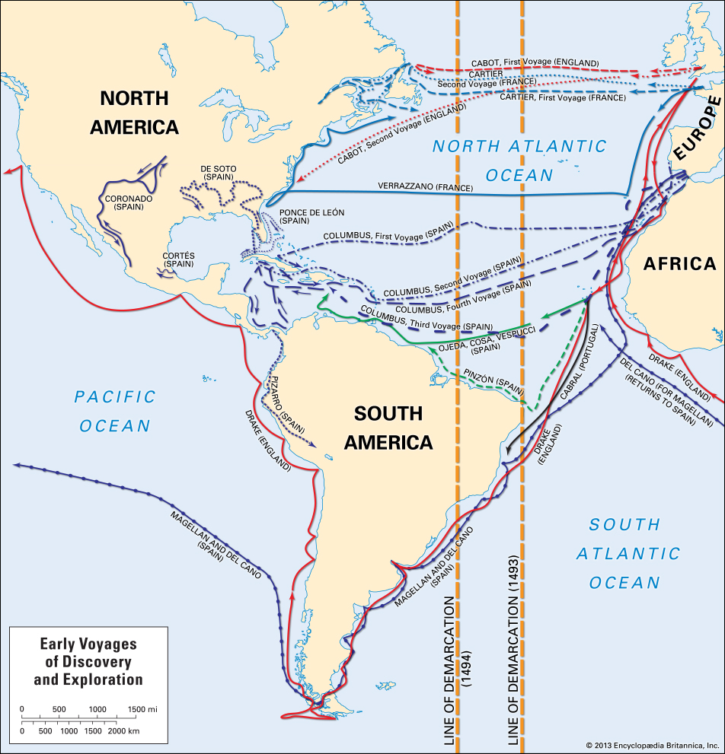

Slide 9
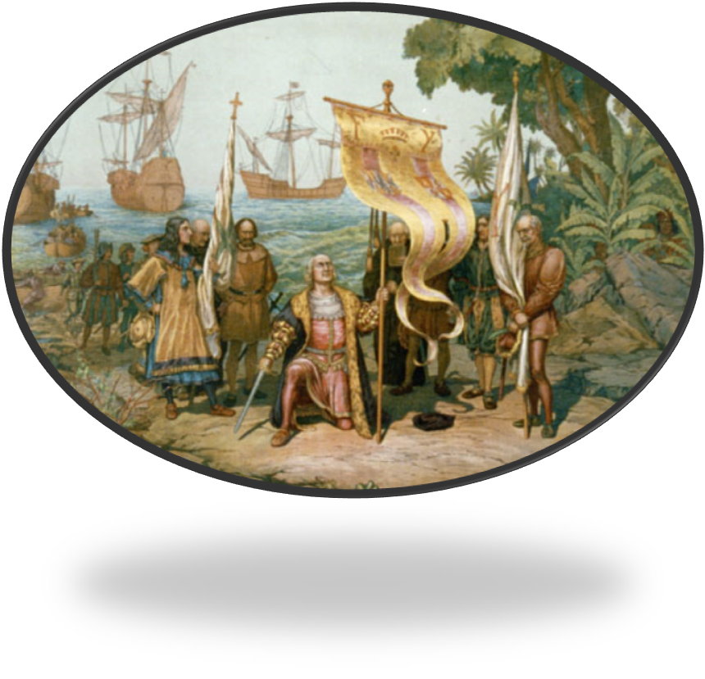
Spanish Exploration Brief Intro
Columbus

Slide 10
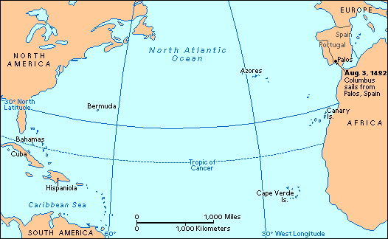
Explain what Columbus did in 1492
Credited for discovering America:
Italian navigator sailing for Spain and seeking westward route to Asia. Thought Caribbean was Asia. Took Indians to Spain. Took colonist back to America. Arrested after colonies mismanaged. Cabot and Vespucci followed to N. America.

Slide 11
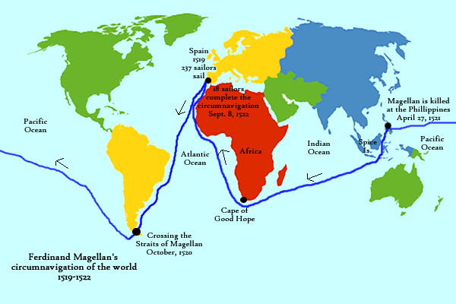
Explain what Magellan did in 1519
First to circumnavigate the world
Sailed west from Spain, cut through S. America at the Straight of Magellan to Pacific, sailed and starved for one month to Asia. Magellan dies in Philippians. Crew finishes without him.

Slide 12
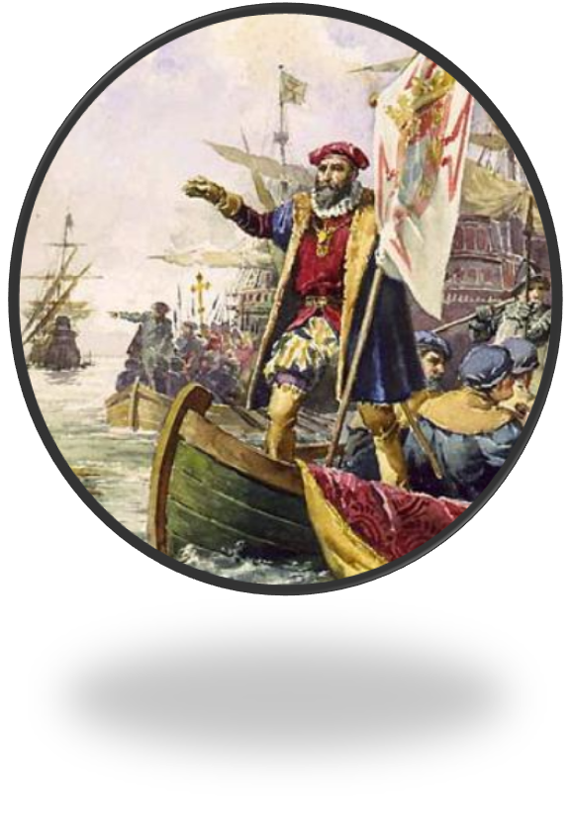
Portuguese Exploration
Vasco da Gama

Slide 13
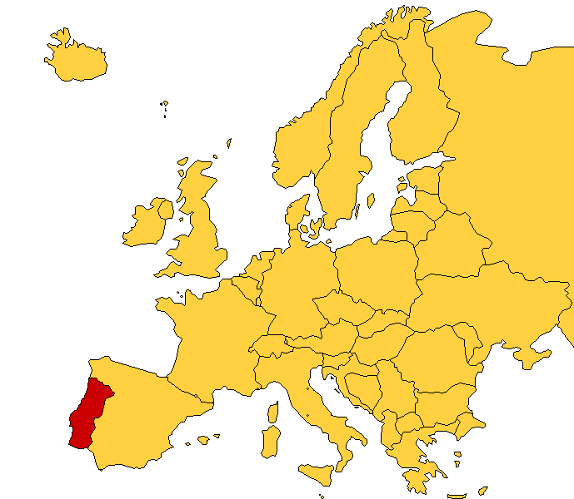
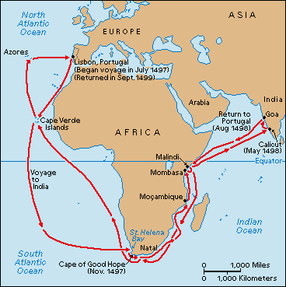
What do you know about Portuguese exploration?
1. Small country with big interest. Prince Henry the Navigator spends his own money on expert group to secretly prepare a crew.
Set up trade and colonies on east coast of Africa. Used cannons to negotiate trade rights with locals.
Dias and da Gama = India. Kick out Muslims, set up trade rights with locals.
Competition with Italy for Asian goods means cheaper items for Europeans, demand goes up, Portugal makes money.
They had nothing to trade to Asia, must pay in gold. Not powerful enough to colonize Asia, like they did in the Central and South America.

