Slide 1
Roman Government

Slide 2
3 Branches of Government
Beginning of Rome: Rome’s type of government changed a LOT. Kings, dictators, democracy, republic, etc
Eventually their ideas of government developed out of Greece’s direct democracy.
Rome wanted a way to prevent a single person from having too much power
So they created 3 different branches of government with different powers. Sound familiar?

Slide 3
Before 2nd Century BC
Consuls (2): both patricians
One could veto the other. “Veto”=“I forbid it”
Controlled army
Declare war
Tax
create laws
receive advice from Senate
(usually do what Senate wants)
Senate (300)
wealthy families in Rome
Member for life
advised the consuls
could not make laws
Tribunes
spoke for the poor
could veto Senate’s vote
elected by Plebeians
Free Citizens
could vote on large issues
elected consuls, senate
Notes:
Economic and political Unrest
-Wealthy large-land owners became extremely wealthy and small-land owners couldn’t compete
-small farmers lost their land and had to move into the city (creating a large poor population)
two brothers, Tiberius and Gaius Gracchus urged the council of plebs to give more land to the poor
Brothers were killed
Eventually civil wars broke out between the wealthy landowners and military vs the poor

Slide 4
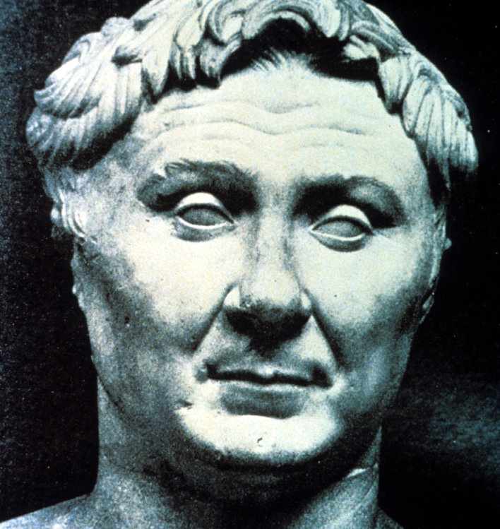
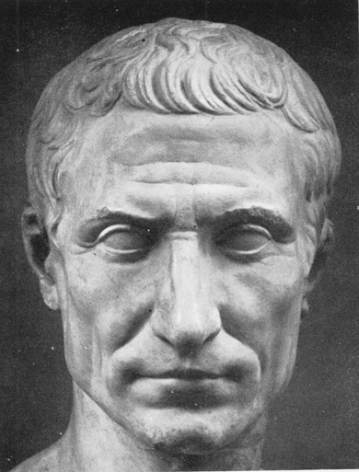
Crassus
(richest man in Rome)
Pompey
(military hero)
Julius Caesar
(military commander
in Spain)
Crassus, Pompey & Julius Caesar= victors in the civil wars
“The First Triumvirate”
Triumvirate= a government by three people with equal power
Notes:
Crassus, Pompey & Julius Caesar emerged as victors in these civil wars
Crassus was richest man in Rome
Pompey was a military hero
Julius Caesar was a military commander
The 3 combined was a huge wealth and power team. “The First Triumvirate”
“Triumvirate”=a government by three people with equal power
Pompey was given command in Spain
Crassus was given command in Syria— who died
Caesar was given military command in Gaul (France)
The Senate told Caesar that Pompey will be given control but Caesar decided to defeat Pompey and march to Rome and take control.

Slide 5
Julius Caesar
Titled dictator in 45BC
Dictator=absolute ruler
Dictators were usually only temporary in emergencies
Gave land to poor
increased size of senate with his supporters
The Senate feared he would remain dictator for life
Was assassinated on his throne in front of the Senate - 44BC
Notes:
Senate members decided he needed to be killed to stop him from being a dictator for life.
On March 15th, He was scheduled to appear before the senate. The Senate members decided it would be the bst place since weapons were not allowed and his friends could not protect him
Caesar had visited an oracle earlier who told him she said death in his near future. His wife also had a nightmare about his death. Fearing the omens, Caesar canceled his appearance
His close friend Decimus, went to his house to convince him to go and it worked
Caeser went to the house and sat on his gold throne as some members snuck in daggers under their togas
A man approached caesar and pulled his toga off his shoulder and men began to stab him. Be probably received at least 23 stabs to his body

Slide 6
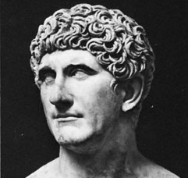
After Caeser’s death…
2 men divided the empire
Octavian (Caeser’s grandnephew) took the west
Mark Antony (caeser’s assissant) took the east
Eventually the two leaders and their armies went to battle for the entire empire.

Slide 7
Mark Antony allied with the Egyptians (plus he had a relationship with queen Cleopatra VII)
They were defeated by Octavian and they fled to Egypt where they committed suicide together
“Antony was the first to commit suicide, by the sword. Cleopatra threw herself at Octavian’s feet….It was not her life she was after…but a portion of her kingdom. When she realized this was hopeless…. she took advantage of her guard’s carelessness to ger herself into the royal tomb. Once there, she put on the royal robes… lay down in a richly perfumed coffin beside her Antony. Then she applied poisonous snakes to her veins and passed into death as though into a sleep”
-Florus, Epitome of Roman History

Slide 8
The Age of Augustus
31 BC-14 AD
At 32 yrs old, Octavian became ruler of all the Roman world.
1st Roman Emperor
Senate changes his name to “Augustus”- the ”revered one”
Civil wars ended
Decided the Senate & Consuls were in charge
Made the Senate vote to give him power of the tribunes (so he could veto the Senate)
Took control over the army. Conquered many lands (except Germany, which made him mad)
This absolute power lasted 1500 yrs

Slide 9
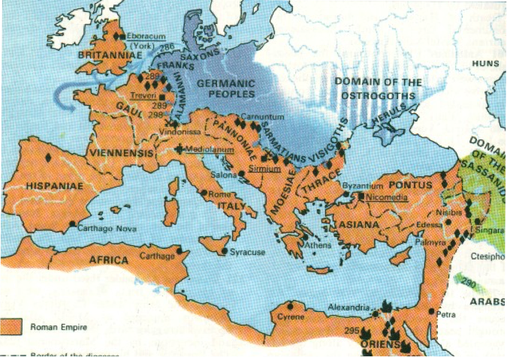
The Early Empire
Augustus’ new political system allowed him to chose his successors (next emperor in line)
After his death in 180AD, the first 4 emperors were from is family.
These emperors took more and more power over time and became very corrupt

