Slide 1
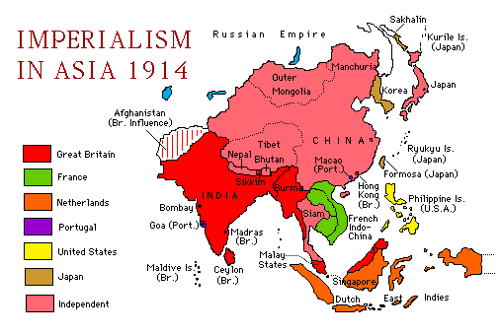
Imperialism in Asia

Slide 2
British Imperialism in India
1800s the British East India Company controlled a large area of India & treated it as a private colony.
However, the rest of India was ruled by local rulers
British East India Company dominated trade of Indian states

Slide 3
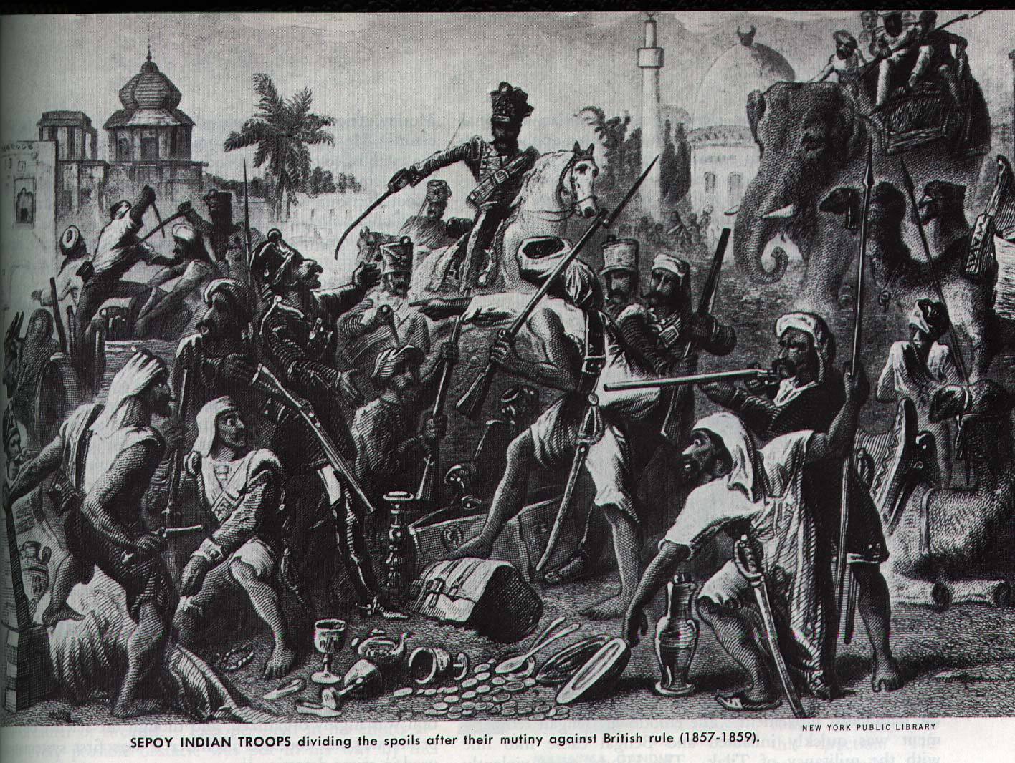
Sepoy Rebellion
Sepoy: Indians trained by the British as soldiers
1857: growing Indian discontent with British rule erupted
Offended by rifle cartridge rumors
Mutiny was harshly crushed by the British
As a result, Great Britain managed strict control over India in 1858

Slide 4
Britain’s Effects on India
Britain built India’s infrastructure
Bridges, Roads, Railroad, and Telegraph Lines.
Introduced medical innovations and Western framing techniques.
British saw themselves as a superior race.
Lead to an Indian Nationalistic movement in the mid-1800s.
Indian National Congress which wanted to rid India of Britain’s influence by using non-violent methods
Notes:
Britain built India’s infrastructure such as rail, telegraph lines, dams, canals to make India more like a modern European country.
However, Indians were treated like second class citizens in their own country and were often discriminated against.
Indian Nationalism started to develop by the late 1800s to resist British control. They formed the Indian National Congress in 1885 and called for self-rule by the early 1900s.

Slide 5
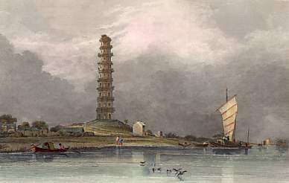
China
For Hundreds of years China had been a productive and powerful country.
By 1800, China had 300 million people but was still self-sufficient and had little desire for foreign goods.
China regarded its products as superior to Europe’s and was resistant to trade.
Chinese rulers restricted Europe to foreign enclaves in select areas.
Chinese port c. 1830

Slide 6
China Wants Opium!
Britain needed to find something China would buy from Europeans.
The product they found was Opium, a highly addictive narcotic, which was restricted in China.
However, British merchants smuggled Opium into China in huge quantities so that China’s government could not properly restrict its use.

Slide 7
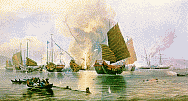
The Opium Wars
China tried diplomacy to convince Britain to stop selling opium to their people. Britain refused prompting a war with China.
Britain easily defeated China in the Opium wars and then forced China to sign the Treaty of Nanking in 1842. This began a century of humiliation for China.
The Opium Wars were fought primarily at sea, and China’s ships were no match for the British fleet

Slide 8
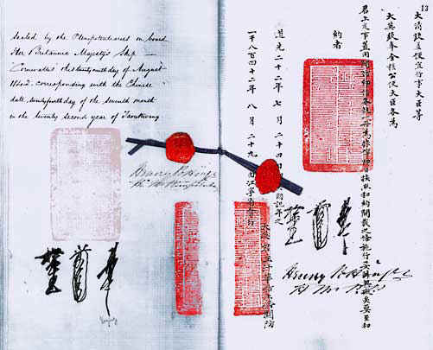
The Treaty of Nanking
The Treaty of Nanking favored the British in a number of ways.
China was forced to pay for all of the opium they destroyed
Britain won the right to trade at four other ports in China
British citizens were given extra-territorial rights and did not have to obey Chinese law
Other countries followed Britain’s lead and later established spheres of influence where they could basically do as they please
The signature page of the Treaty of Nanking.

Slide 9
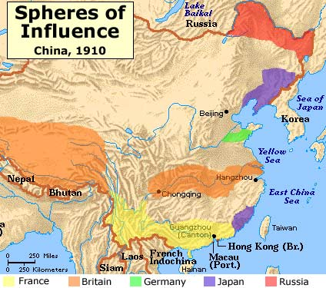

Slide 10
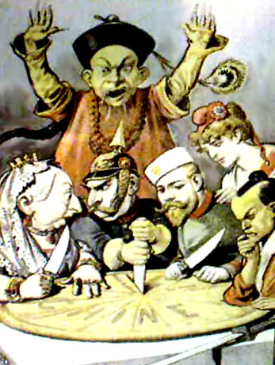
IMPERIALISM IN CHINA
Ruler of China: Manchu Qing
“Marianne:” The symbol of France
Kaiser Wilhelm II of Germany
Tsar of Russia: Nicholas II
Queen Victoria I of Great Britain
Japanese Samurai
Notes:
Insert a picture with the arrows
This French political cartoon shows the 5 rulers dividing up China into spheres of influence. Note that the rule of China does not have any say into their dividing up the territory and trading rights.

Slide 11
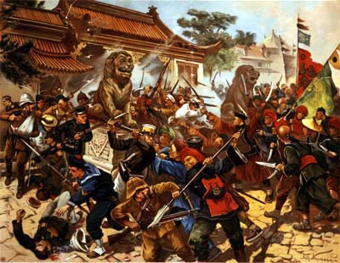
Chinese Nationalism: The Boxer Rebellion
Many Chinese resented the presence of foreigners in China.
They began to form secret societies designed to rid China of foreign influence. One of the most famous of these groups was known as the Boxers, and in 1900 they laid siege to European section of Peking for several months.
A coalition of European forces was called on to free the Europeans and defeat the Boxers.
The Society of Righteous and Harmonious Fists, known as the “Boxers” sought to rid China of “Foreign Devils”

Slide 12
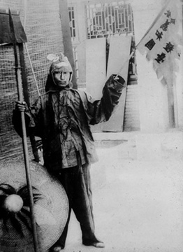
Impact of the Boxer Rebellion
The Boxers were easily defeated by the Europeans, and things got worse for China as foreigners now wanted to strengthen their influence in China.
However, the humiliation of China caused ideas of nationalism to stir as people wanted to change their government, economy and culture.
A Chinese “Boxer”

Slide 13
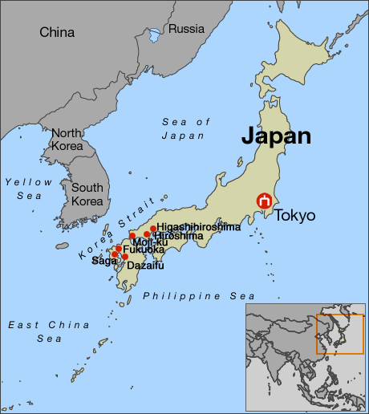
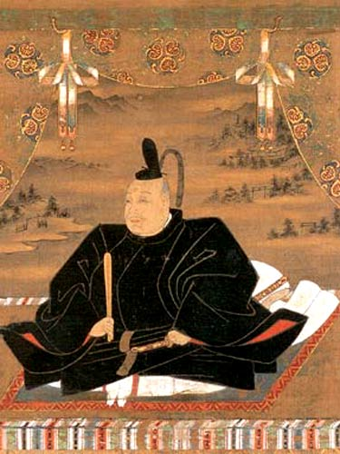
Japan : 1850
Japan had changed very little since the 1600s when it had adopted the policy of isolationism.
It had been a very stable country under its rulers, the Tokugawa shoguns, but had only contact with China and very limited contact with the Netherlands.

Slide 14
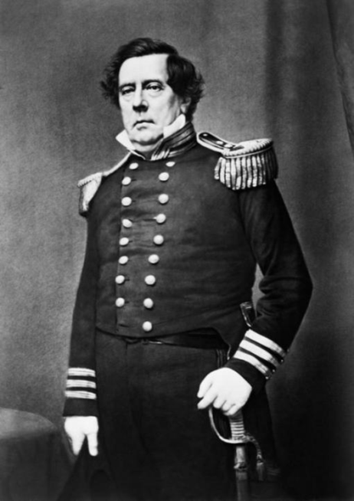
America Opens Japan to Trade
In 1853 American admiral Matthew Perry brought four steam warships into Tokyo’s harbor and demanded that Japan trade with America and let them dock their boats in Japan.
Japan’s military technology was no match for the Americans and they agreed to trade with the United States.
Other countries soon signed similar treaties with Japan, forming a situation similar to China’s.

Slide 15
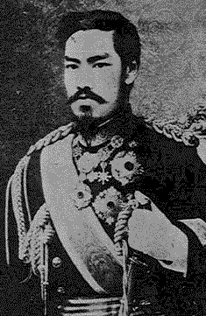
The Meiji Period Changes Japan
Japan did not want to end up like China and a new group of leaders replaced the Tokugawa Shogunate in 1868. This period of time (1868-1912) is known as the Meiji period.
During this time adopted changes in government, promptly ending feudalism. Its leaders also sought to modernize and visited Europe to study new technologies.
Emperor Meiji of Japan, reigned during Japan’s period of modernization. However, he still held no real power as it was concentrated in the hands of a few powerful military leaders.

Slide 16
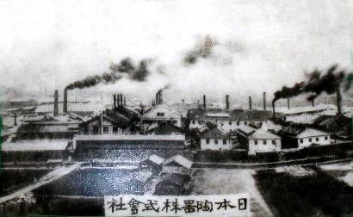
Japanese Modernization
Japan industrialized and modernized at lightning speed. They improved in several areas.
In a 30 year period they built thousands of miles of railroad track, thousands of factories, and increased their coal production by 4000%.
Japan also modernized their army modeling the army after Germany and their navy after Britain.
Japan quickly built factories and became an industrial country in an attempt to compete with the rest of the world.

Slide 17
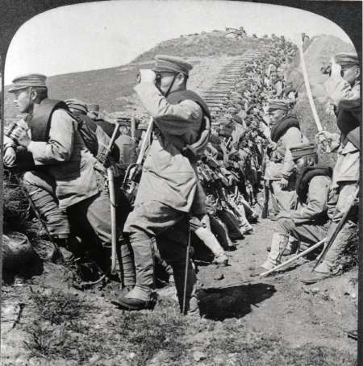
Japan begins Imperialism
Japan’s powerful army allowed them to renegotiate trade agreements with Europe and put them on an equal footing.
Japan also used their army against China and took control of both Korea and parts of Northern China.
Japan’s efforts in Asia upset Russia, who went to war with Japan in 1904. Japan surprisingly defeated Russia rather easily in the Russo-Japanese war. As a result, Japan was now an undeniable world power.

